Slide 1
Psychology
3.3 Memory
Notes:
Pre-test – Ed Perfect

Slide 2
Brain Structures and Memory

Slide 3
Learning Objectives
Describe the role of the hippocampus, the neo-cortex and the amygdala in forming and storing explicit memories.
Describe the role of the cerebellum in forming implicit memories.

Slide 4
Brain Structures and Memory
Very difficult to find specific locations of memories, thoughts, ideas or events
However, there is some understanding of the brain structures that play a role in memory formation
These include the:
Hippocampus - Declarative
Cerebral cortex – Short term / declarative
Cerebellum – Procedural / implicit
Amygdala – explicit
Basal ganglia – procedural

Slide 5
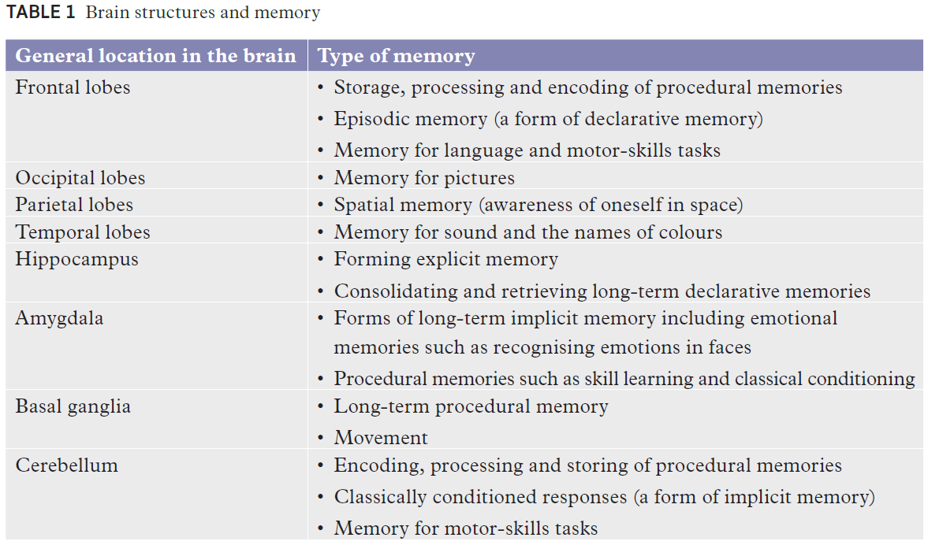

Slide 6
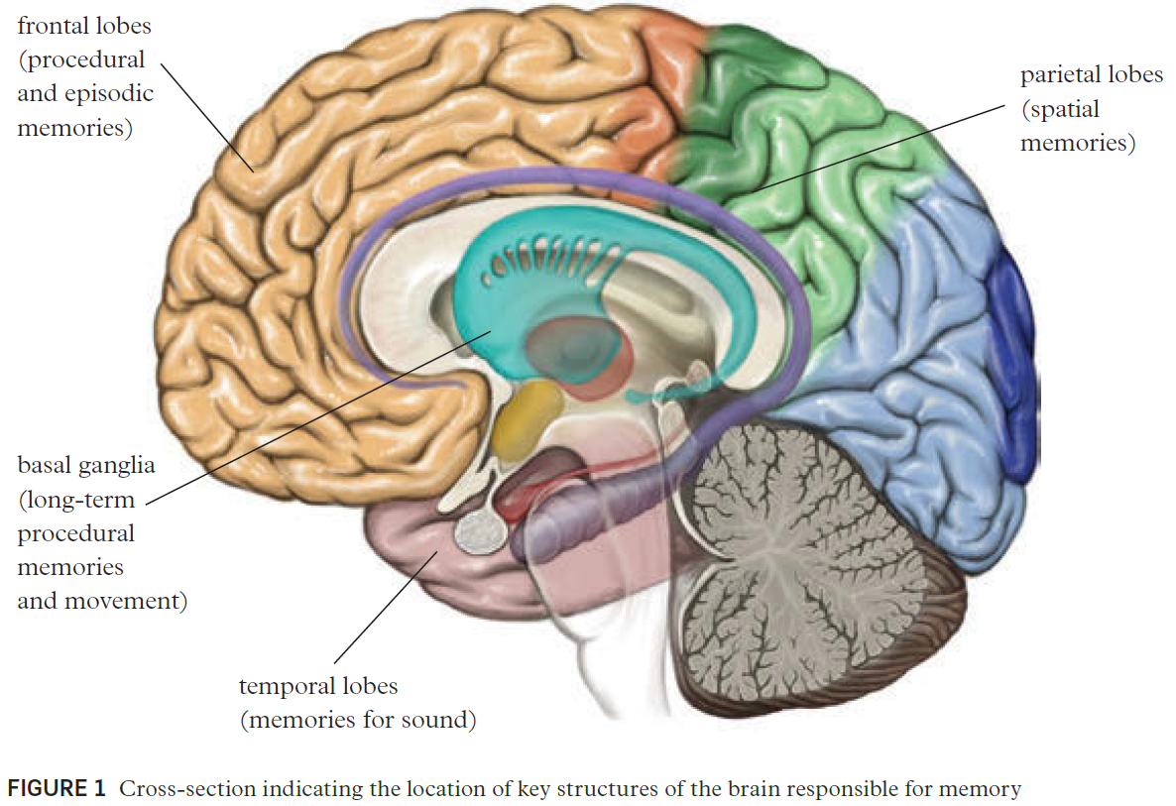
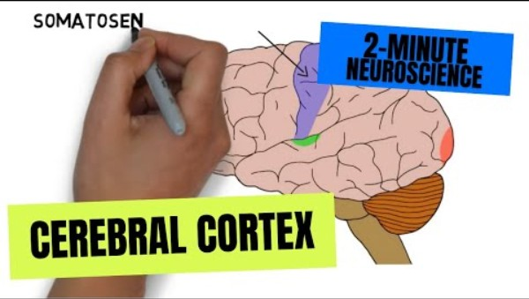
The Role of the Cerebral Cortex
The Cortex houses a number of different structures that are linked to the formation and storage of procedural memories

Slide 7
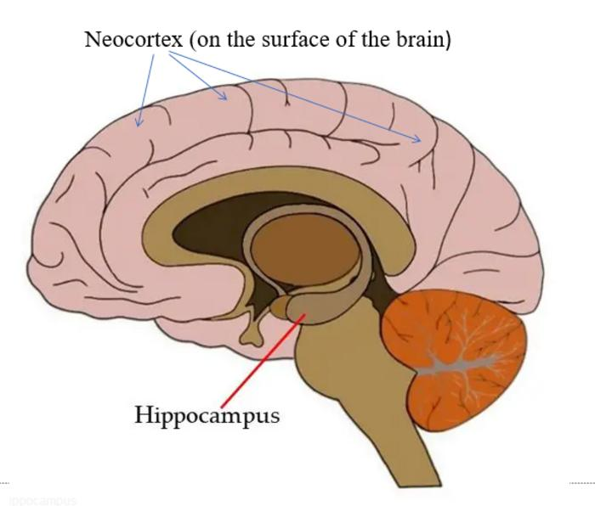
The Hippocampus
Tiny structure with two halves – one in each hemisphere
Positioned in the medial temporal lobe
Generally larger in women
Connected to the frontal lobe, thalamus and amygdala
Part of the limbic system (emotions, learning and memory)

Slide 8
The Hippocampus and Memory
The hippocampus helps to provide meaning to new information by providing context to it
i.e. location, situation, places etc.
Plays a role in the encoding and temporary storage of declarative memories
After context has been applied, these memories are then transferred to long term storage in other regions of the cortex
The hippocampus also has the ability to produce new cells allowing for learning and greater memory formation
Particularly important during declarative (semantic) memory formation such as a child learning new words
Notes:
Ask students to recall what a declarative memory is – (explicit, requires conscious thought, personal experiences / events)
- Ask students to recall the taxi driver case study they should have read – next slide for detail

Slide 9
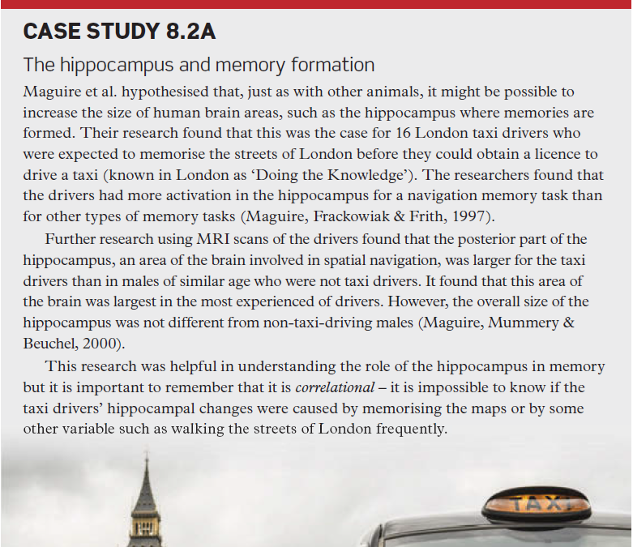
Notes:
Discuss the research conducted by Maguire et al., (1997) which showed the hippocampi of taxi drivers who had to learn new routes in new York city were larger than those of individuals in other professions.

Slide 10
The Hippocampus and Consolidation
Consolidation is the process by which the brain takes a new memory, then encodes and transfers it to permanent long-term storage
Research has shown that the hippocampus plays a role in the consolidation process
This has been shown via neuroimaging techniques as well as by experimental procedures on rats where the hippocampus has been disabled or impacted in some way and memory subsequently tested
The hippocampus is responsible in both the consolidation (moving info from STM to LTM) of new declarative memories and their retrieval
Research also suggests that the hippocampus is reasonably active during slow-wave sleep when the rest of the brain is less active and when memories are theorised to be processed – i.e. consolidation continues to happen whilst asleep
Notes:
The more activated the hippocampus is during learning/memory formation, the more information is retained
Ask students to recall the rat case study they should have read – next slide for detail
Research has found that those who slept well within the first 30 hours of learning continued to perform better on visual discrimination tasks

Slide 11
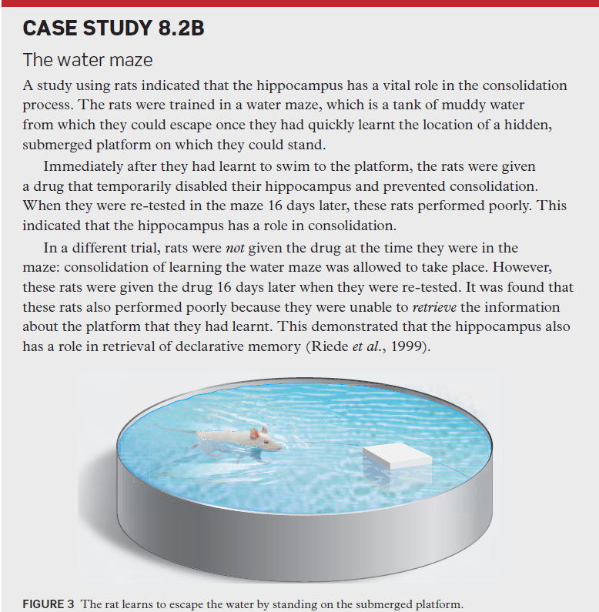
Notes:
Discuss the research

Slide 12
Emotion and Memory
Remember – The role of the amygdala
The hippocampus has a direct connection to the amygdala
This connection allows for links to be made between memories and emotions and emotions and memories
i.e. emotions that are elicited from particular memories and memories that are triggered by particular emotions
The amygdala is essential for implicit memory formation
Helps activate the hippocampus for consolidation of memories with emotional content (e.g. winning a competition)
Notes:
Ask students to recall the role of the amygdala – emotional connections
Ask students to define implicit - Memories about skills, emotions, preferences, disposition, motor skills conditioning (procedural)

Slide 13
Damage to the Hippocampus
As has been demonstrated by studies, damage to the hippocampus can disrupt memory formation and retrieval
But hippocampus function can be impacted by many things including
Stress (if prolonged over time = shrinkage)
Anxiety
Depression
PTSD
Health conditions / disease -Alzheimer’s, demetia
Viruses (herpes, encephalitis)
Notes:
Ask students to recall the role of the amygdala – emotional connections
Ask students to define implicit - Memories about skills, emotions, preferences, disposition, motor skills conditioning (procedural)

Slide 14
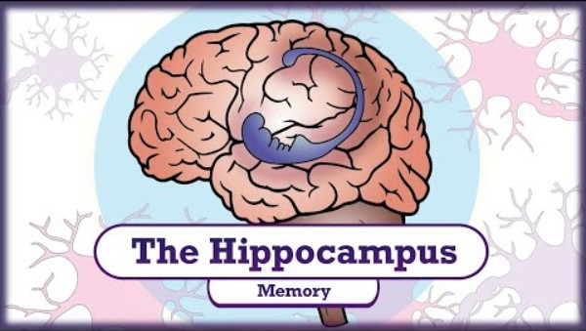
Extension video

Slide 15
The neo-cortex
Plays a role in memory formation and retrieval
Largest part of the cerebral cortex
The sheet of neural tissue that forms the outside surface of the brain
Distinctive by its wrinkly appearance.
Association areas link sensory inputs with past experiences
Stores declarative memories like facts, events, and concepts, in a distributed way across different regions
The prefrontal cortex: Involved in working memory and short-term storage of information
The temporal lobe: Contributes to long-term memory consolidation and retrieval
Connections between the neocortex and subcortical structures regulate emotional memory processes

Slide 16
The neo-cortex
In humans, it is involved in higher functions
Sensory perception, generation of motor commands, spatial reasoning and language
Over time, information from certain memories that are temporarily stored in the hippocampus can be transferred to the neocortex as general knowledge
Things like knowing that coffee provides a pick-me-up.
Researchers think this transfer from hippocampus to neocortex happens as we sleep.

Slide 17
The amygdala
An almond-shaped structure in the brain’s temporal lobe
Attaches emotional significance to memories.
Modifies the strength and emotional content of memories
Strong emotional memories (e.g. those associated with shame, joy, love or grief) are difficult to forget
Also plays a key role in forming new memories specifically related to fear
Fearful memories are able to be formed after only a few repetitions.
Therefore, fear learning is a popular way to investigate the mechanisms of memory formation, consolidation and recall
Understanding how the amygdala processes fear helps understand disorders like PTSD
Anxiety in learning situations is also likely to involve the amygdala
May lead to avoidance of particularly challenging or stressful tasks

Slide 18
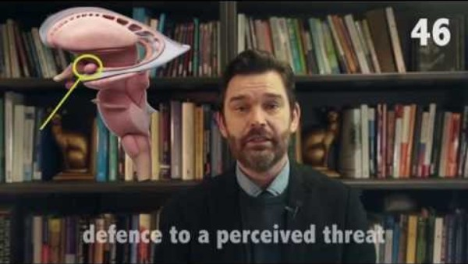
The amygdala

Slide 19
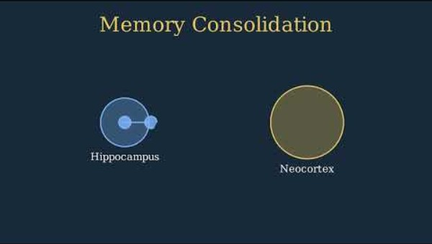
Putting it together…

Slide 20
Learning Objectives
Describe the role of the hippocampus, the neo-cortex and the amygdala in forming and storing explicit memories.
Describe the role of the cerebellum in forming implicit memories.

Slide 21
The Cerebellum and Memory
The cerebellum plays a role in the formation of procedural memories, specifically motor skills
It works closely with a number of the structures in the frontal lobes to encode and process information
Putamen, caudate nucleus and the motor cortex
Involved in both the formation and retrieval of procedural memories
It is the cerebellum that allows for the automation of many motor activities (riding a bike, tying shoe laces etc.) by activating the relevant neural pathways required for the task
Notes:
Activity - Get students to recall the role of procedural memory - Memories about skills, emotions, preferences, disposition, motor skills, conditioning – unconscious retrieval

Slide 22
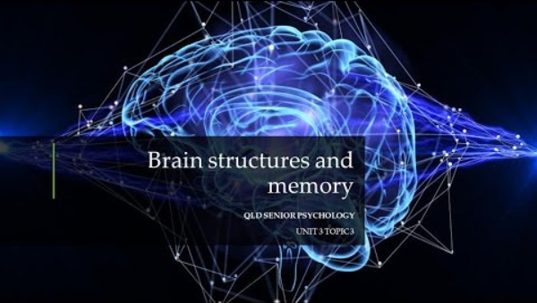
The Cerebellum and Memory

Slide 23
Hippocampus, Amygdala and Cerebellum Studies
It was due to patients with brain damage to the hippocampus that researchers were able to discover that there are actually two kinds of LTM - Implicit / Explicit
Brain scans that showed one part of the brain (hippocampus) was active for explicit (declarative) and another area (cerebellum) for implicit (procedural)
i.e. Damage to the hippocampus means that procedural learning can still occur(controlled by cerebellum) but remembering how to perform a task or skill (declarative) is not possible.
Similarly studies of patients with damage to the amygdala have shown that while participants might initially react emotionally to a stimulus with an emotional connection, they will not store that emotional connection to their memory
E.g. Bechara – blue slide experiment and noise
Notes:
Discuss Bechara study with students in detail and connotations for conditioned responses

